Slide 1
Presentation On
Different Types Of Distortion in Optical Fiber Communication
#Group 3

Slide 2
Distortion in Optical Fiber
Dispersion
Attenuation
Intramodal Dispersion
Bending Loss
Intermodal Dispersion
Absorption Loss
Polarization Mode Dispersion
Scattering Loss

Slide 3
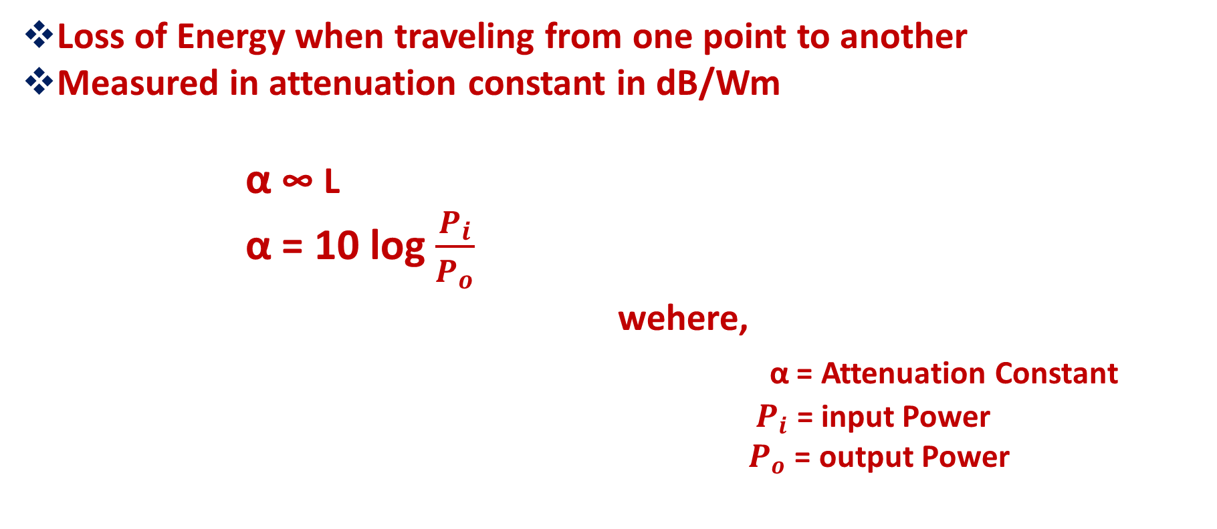
Attenuation
Loss of Energy when traveling from one point to another
Measured in attenuation constant in dB/Wm
α ∞ L
α = 10 log $\frac{P_{i}}{P_{o}}$
wehere,
α = Attenuation Constant
$P_{i}$ = input Power
$P_{o}$ = output Power

Slide 4
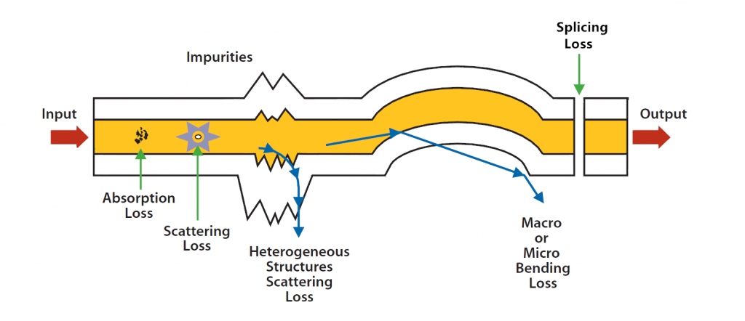
Attenuation
Loss Happens due to
Bending Loss
Absorption Loss
Scattering Loss

Slide 5
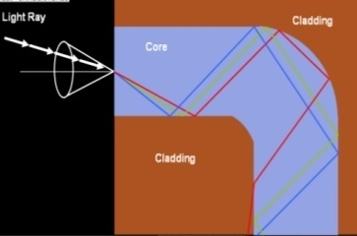
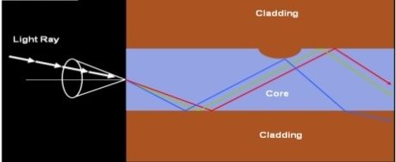
Bending Loss
Loss of light energy due to Bending
Types Of Bending Loss
Macroscopic Bending
Macroscopic Bending
Completely Bends the fiber
2. Microscopic Bending
Slightly Bends the core and cladding
Microscopic Bending

Slide 6
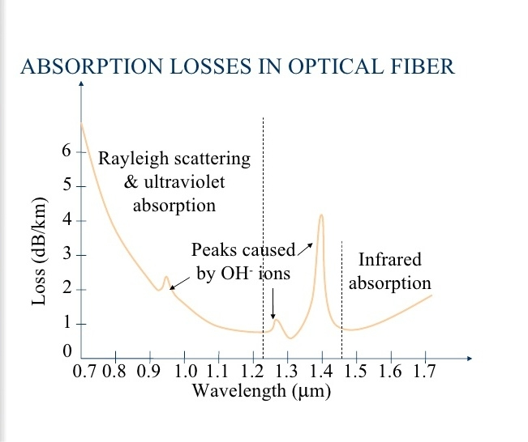
Absorption Loss
Light is absorbed and loss energy
Types Of absorption Loss
Intrinsic Absorption
Interacts within glass particles and absorb required energy from signal
2.Extrinsic Absorption
Energy absorbed by external impurities
i.e iron,chromium,OH-

Slide 7
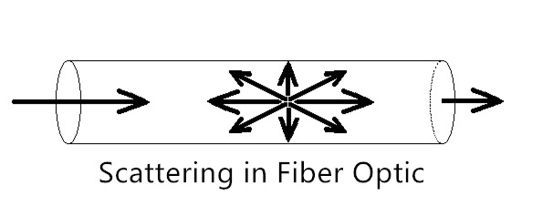
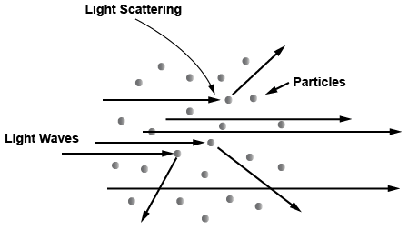
Scattering Loss
Light is hindered and deviates from the path
Reasons Behind Scattering Losss
Microscopic variations in material density
Compositional Fluctuations
Manufacturing Defects
Structural Homogenities

Slide 8
Reduction Of Losses
To Reduce Scattering, The refractive index of core must be increased and pefect manufacturing
To Reduce Absorption, Perfect doping is needed
Using Multi-mode fiber and perfect fabrication Bending loss can be reduced.
High suitable heat Shrinkable tube
Insertion loss should be lower than 0.3 dB

Slide 9
Have any Question?

Slide 10
THANK YOU ALL

